Slide 1
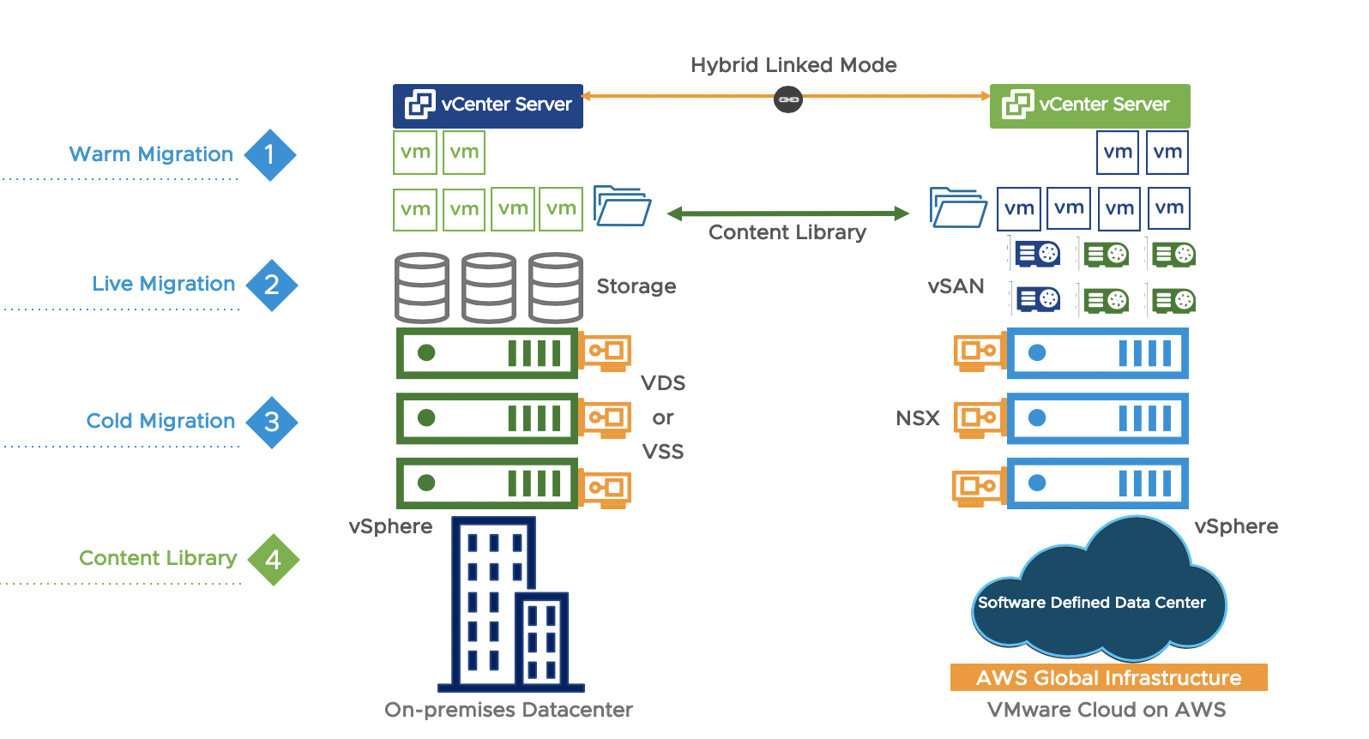
VM Migration
Dr. Shakti Mishra
Slides (Partially) Adopted From: Live Migration of Virtual Machines, Christopher Clark, Keir Fraser, Steven Hand, Jacob Gorm Hansen, Eric Jul, Christian Limpach, Ian Pratt, Andrew Warfield
University of Cambridge Computer Laboratory, University of Copenhagen, Denmark

Slide 2
Physical versus Virtual Clusters
The virtual cluster nodes can be either physical or virtual machines. Multiple VMs running with different OSes can be deployed on the same physical node.
A VM runs with a guest OS, which is often different from the host OS, that manages the resources in the physical machine, where the VM is implemented.
The purpose of using VMs is to consolidate multiple functionalities on the same server. This will greatly enhance server utilization and application flexibility.

Slide 3
VMs can be colonized (replicated) in multiple servers for the purpose of promoting distributed parallelism, fault tolerance, and disaster recovery.
The size (number of nodes) of a virtual cluster can grow or shrink dynamically, similar to the way an overlay network varies in size in a peer-to-peer (P2P) network.
The failure of any physical nodes may disable some VMs installed on the failing nodes. But the failure of VMs will not pull down the host system.

Slide 4
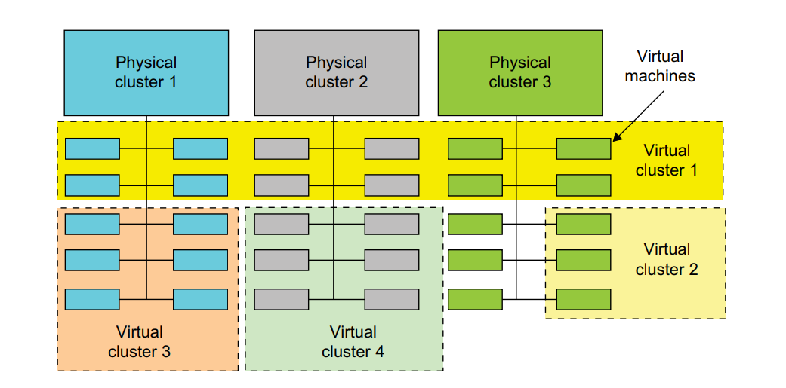
Physical Vs Virtual Clusters

Slide 5
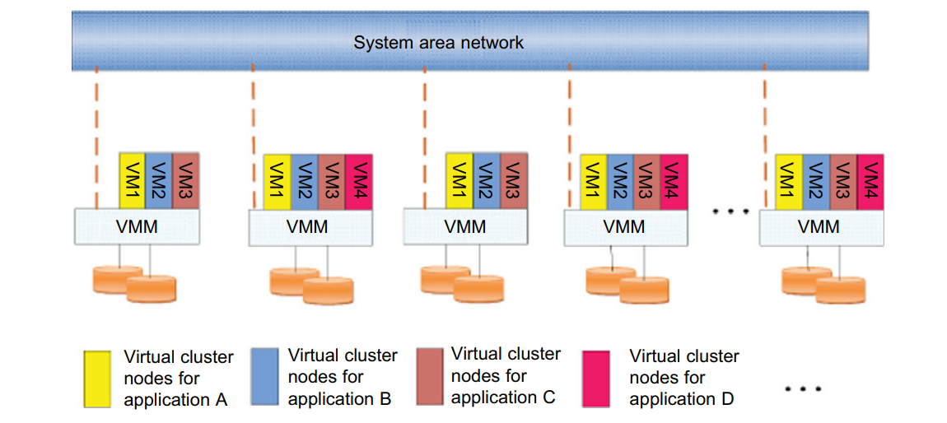
Virtual Cluster

Slide 6
VIRTUAL CLUSTERS AND RESOURCE MANAGEMENT
There are three critical design issues of virtual clusters:
live migration of VMs,
memory and file migrations, and
dynamic deployment of virtual clusters
Basically, there are four steps to deploy a group of VMs onto a target cluster:
preparing the disk image,
configuring the VMs,
choosing the destination nodes, and
executing the VM deployment command on every host.

Slide 7
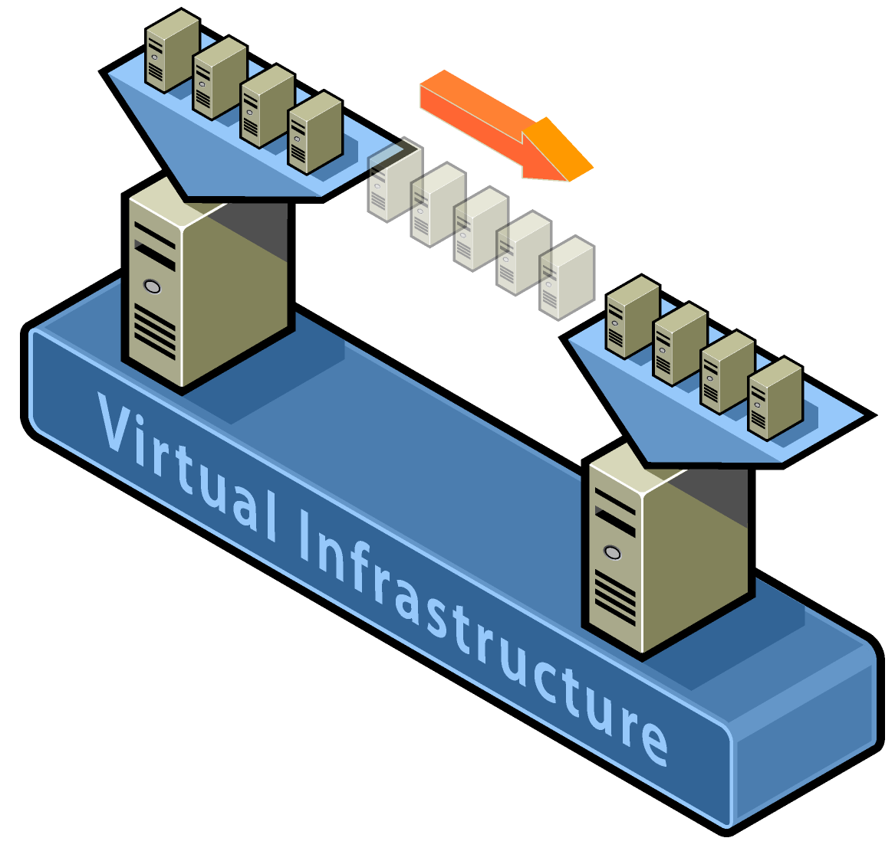
Motivation
What’s VM live migration?
Move VM instances across distinct physical hosts with little or no downtime for running services.
Services are unaware of the migration.
Maintain network connections of the guest OS.
VM is treaded as a black box.

Slide 8
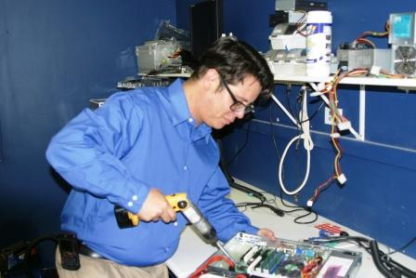

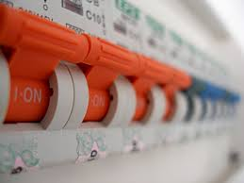
Motivation
VM live migration can be an extremely powerful tool for cluster administrators.
Hardware / Software maintenance / upgrades
Load balancing / resource management
Distributed power management

Slide 9



Design-challenges
Minimize service downtime
Minimize migration duration
Avoid disrupting running service
Source Host
Destination Host
.BIN
.VSV
.XML
Storage
.VHD

Slide 10
Motivation
Why OS-level migration, instead of process-level?
Avoid ‘residual dependencies’
Original host can be power-off / sleep once migration completed.
Can transfer in-memory state in a consistent and efficient fashion
E.g. No reconnection for media streaming application
Allow a separation of concerns between the users and operator of a cluster
Users can fully control of the software and services within their VM.
Operators don’t care about what’s occurring within the VM.

Slide 11
Motivation
Related Work
Approach | Feature
Collective project | stop-and-copy
Zap | stop-and-copy
VMotion | similar with live migration
Process migration | residual dependencies

Slide 12
Design-memory migration
Options
Phase | service downtime | migration duration
push | - | -
stop-and-copy | longest | shortest
pull (demand) | shortest | longest
Pre-copy
a bounded iterative push phase + a very short stop-and-copy phase
Careful to avoid service degradation

Slide 13
Design-local resources
Open network connections
Migrating VM can keep IP and MAC address.
Broadcasts ARP new routing information
Some routers might ignore to prevent spoofing
A guest OS aware of migration can avoid this problem
Local storage
Network Attached Storage

Slide 14

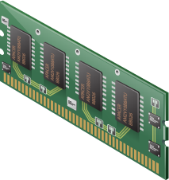



Design-local resources
Virtual Machine
Virtual Machine
Source
Destination

Slide 15
Design-overview

Slide 16
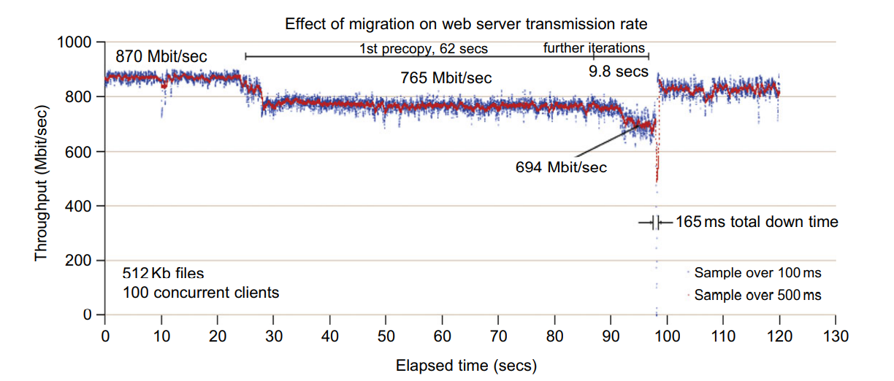
Effect on data transmission rate of a VM migrated from one failing web server to another.

Slide 17
Migration of Memory, Files, and Network Resources

Slide 18
Memory Migration
The Internet Suspend-Resume (ISR) technique exploits temporal locality as memory states.
Temporal locality refers to the fact that the memory states differ only by the amount of work done since a VM was last suspended before being initiated for migration.
To exploit temporal locality, each file in the file system is represented as a tree of small subfiles.
A copy of this tree exists in both the suspended and resumed VM instances.
The advantage of using a tree-based representation of files is that the caching ensures the transmission of only those files which have been changed.
The ISR technique deals with situations where the migration of live machines is not a necessity.

Slide 19
Implementation-writable working sets
Significant overhead: transferring memory pages that are subsequently modified.
Good candidates for push phase
Pages are seldom or never modified.
Writeable working set (WWS)
Pages are written often, and should best be transferred via stop-and-copy
WWS behavior
WWS varies significantly between the different sub-benchmarks
Migration results depend on the workload and the precise moment when migration begins

Slide 20
File Migration
Provide each VM with its own virtual disk which the file system is mapped to and transport the contents of this virtual disk along with the other states of the VM.
Migration of the contents of an entire disk over a network is not a viable solution.
A global file system across all machines where a VM could be located.
VMM only accesses its local file system. The relevant VM files are explicitly copied into the local file system for a resume operation and taken out of the local file system for a suspend operation.
In smart copying, the VMM exploits spatial locality

Slide 21
Network Migration
The VMM maintains a mapping of the virtual IP and MAC addresses to their corresponding VMs.
If the source and destination machines of a VM migration are typically connected to a single switched LAN, an unsolicited ARP reply from the migrating host is provided advertising that the IP has moved to a new location.
On a switched network, the migrating OS can keep its original Ethernet MAC address and rely on the network switch to detect its move to a new port.

Slide 22
Implementation-managed & self migration
Managed migration
Performed by a migration daemon running in the management VM
Self migration
Within the migratee OS, and a small stub required on the destination host
Difference | Managed | Self
Track WWS | shadow page table + bitmap | bitmap + a spare bit in PTE
Stop-and-copy | suspend OS to obtain a consistent checkpoint | two-stage stop-and-copy, ignore page updates in last transfer

Slide 23
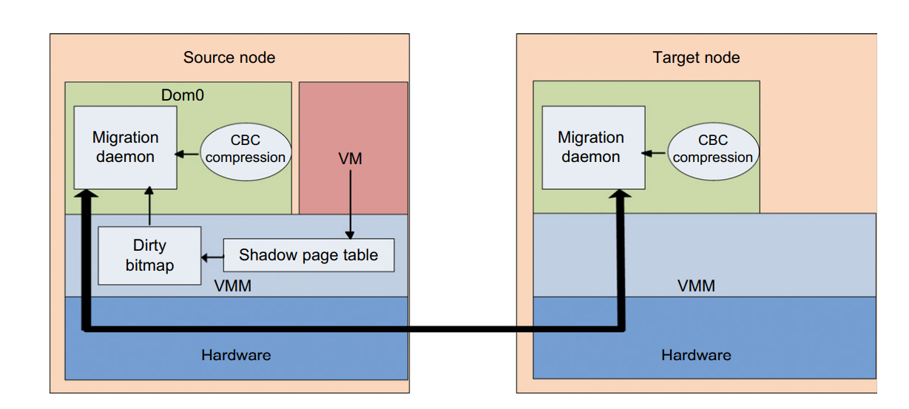
Live Migration of VMs between Two Xen-Enabled Hosts

Slide 24
Implementation-track WWS (managed)
Using shadow page table to track dirty pages in each push round
Xen inserts shadow pages under the guest OS, populated using guest OS's page tables.
The shadow pages are marked read-only.
If OS tries to write to a page, the resulting page fault is trapped by Xen.
Xen checks the OS's original page table and forwards the appropriate write permission.
At the same time, Xen marks the page as dirty in bitmap.
At the beginning of next push round
Last round’s bitmap is copied to the control software, Xen’s bitmap is cleared.
Shadow page tables are destroyed and recreated, all write permissions are lost

Slide 25
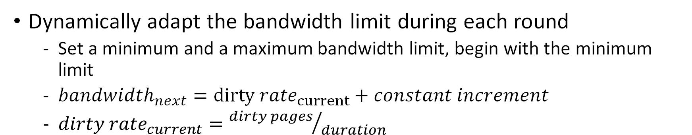
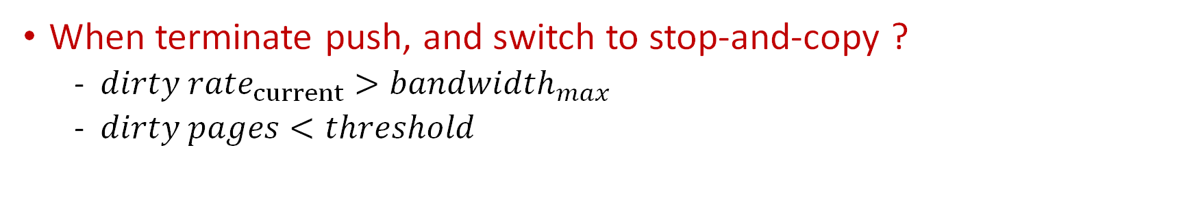
Implementation-dynamic rate limiting
downtime
performance
More network bandwidth, less service downtime !
Less network bandwidth, less impact on running service !
Dynamically adapt the bandwidth limit during each round
Set a minimum and a maximum bandwidth limit, begin with the minimum limit
${bandwidth}_{next}={dirty rate}_{current}+constant increment$
${dirty rate}_{current}={dirty pages}/{duration}$
When terminate push, and switch to stop-and-copy ?
${dirty rate}_{current}>{bandwidth}_{max}$
$dirty pages<threshold$

Slide 26
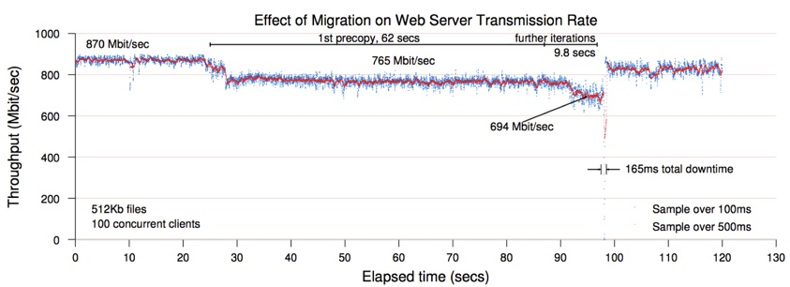
Evaluation-simple web server
Migration starts
A highly loaded server with relative small WWS
Controlled impact on live services
Short downtime

Slide 27
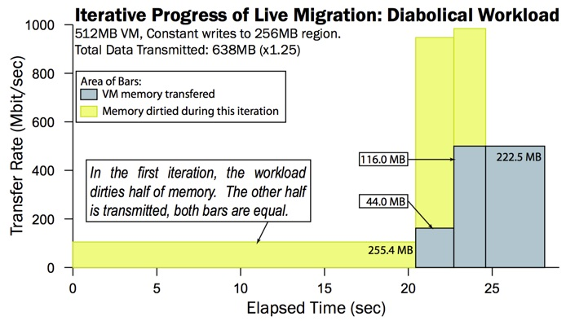
Evaluation-rapid page dirtying
Stop-and-copy
In the third round, the transfer rate is scaled up to 500Mbit/s (max)
Switch to stop-and-copy, resulting in 3.5s downtime
Diabolical workload may suffer considerable service downtime

